Slide 1
School of Metta
Tuệ Tâm English Dhamma School of Metta
Lesson 10 – Conscious behaviors

Slide 2
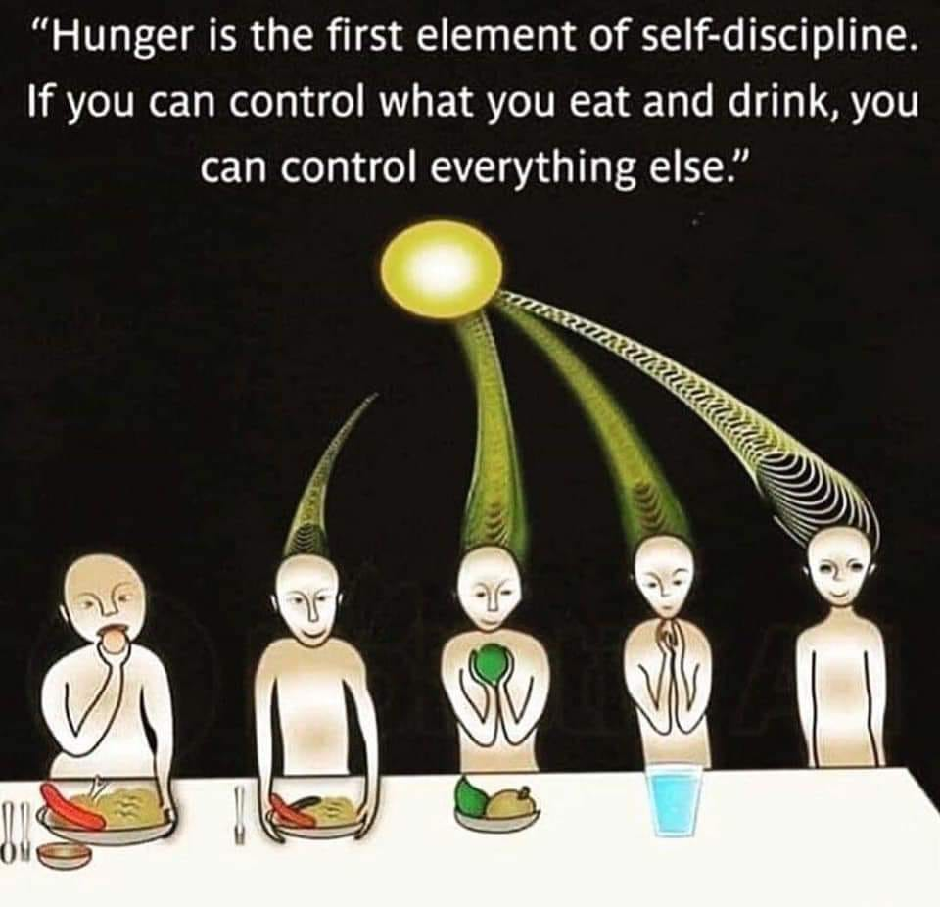

Slide 3
References of interests
https://interestingengineering.com/10-year-old-girl-has-a-higher-iq-than-einstein-and-hawking?utm_source=Facebook&utm_medium=Article&utm_campaign=organic&utm_content=Sep07&fbclid=IwAR0-GsF0TMz8eOU9Xsxg9kgukcsXRd1-b8F0uJjKZJB7yD31BPhQ_YgF74I
Please read this article and give your feeling and opinion.
Can IQ be trained ?

Slide 4
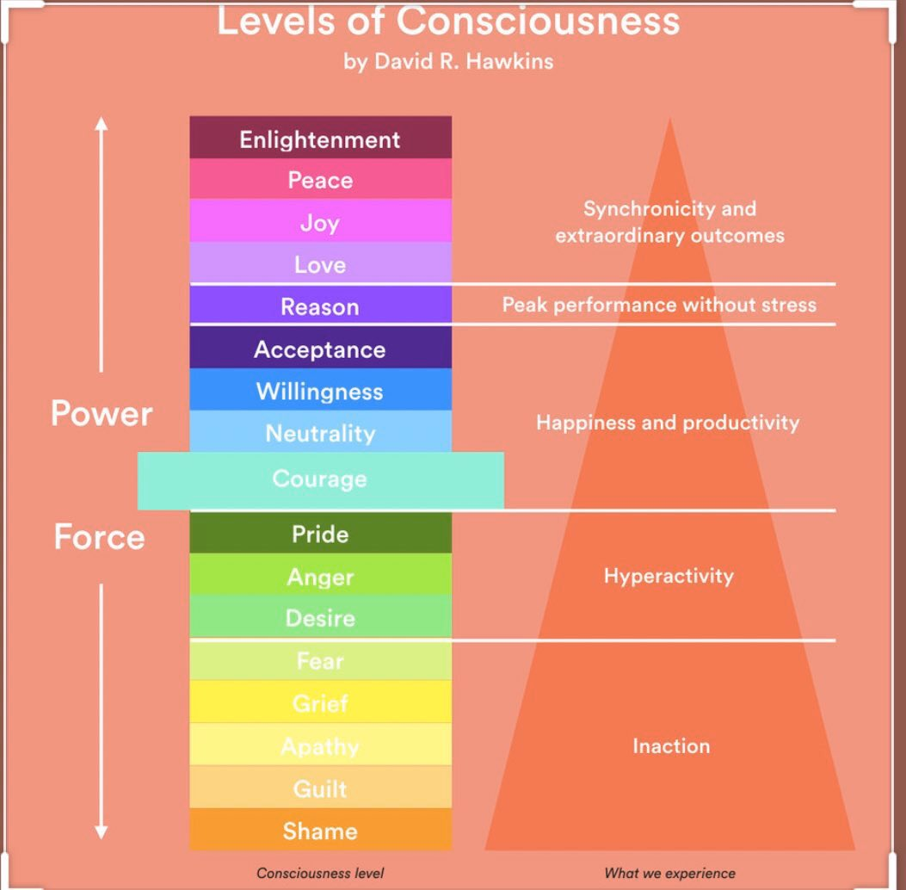

Slide 5
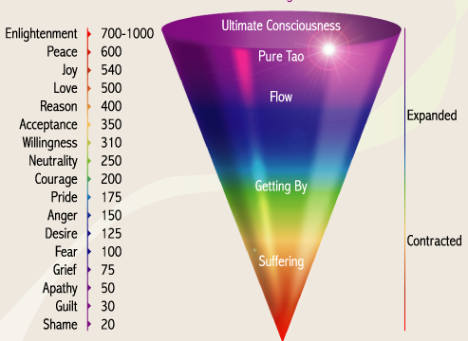

Slide 7
Assignment
What is the consciousness? Is it learned or born naturally? How do you transform it for betterment?
Is hunger a type of consciousness? Please give your own practical experience on this issue? What did you think in this circumstance? What did you do? If you were in that situation again, what would you do? Would your action be the same or different? Why, please explain it.
Please explain by your own experience where you can resist temptation of eating during your hunger? What was your feeling at that time?

