Slide 1
Meaningful stories
october 03rd 2021

Slide 2
Thinking & sharing
https://www.youtube.com/watch?v=dTS2BV94D_c

Slide 3
DISCUSSION
People say:
“Man is just like a pen or pencil.
Pen after writing cannot erase but Pencil can”
If that were you, which one would you choose ?
Discuss about that by setting up 2 teams to keep your opinions.
Using anyway: your thinking, understanding, internet, diagrams, pictures or video to make your team’s presentation.

Slide 4
GIVING YOU MORE
The story of pencil written by Paulo Coelho
https://www.facebook.com/102336088340423/videos/142165707735951/
“I hope you will be like this pencil when you grow up.” Paulo Coelho
The story of pencil

Slide 5
GIVING YOU MORE
https://www.youtube.com/watch?v=AH0xppVUCug

Slide 6
Thinking & feeling
Have you seen disabled person yet ?
When you saw him/her, how did you feel and what did you think ?
Can you share a small story about this?
(you have 3 min to prepare that)

Slide 7
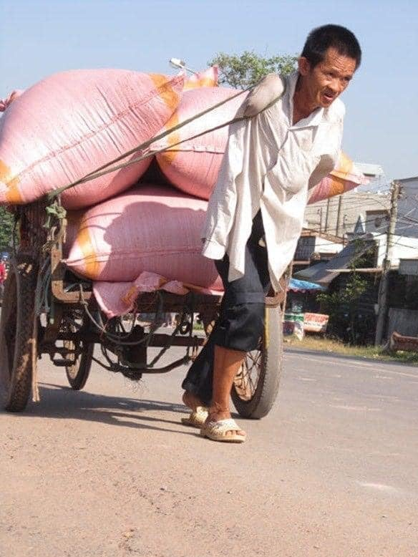
Thinking & feeling

Slide 8
YOUR ASSIGNMENT
How do you interpret the Ads texts to fit the picture of a disabled man hardly working to earn money to pay for his children’ s education?
Requirements: Writing in English, minimum 2000 words with graphics, video, poems or humorous writings. It shall be judged on the levels of entertaining, informal, persuasive and English standards. All sources of information inclusive of graphics, poems etc... enclosed in the writing must be acknowledged.
Deadline: 18PM Friday 08th October 2021

Slide 10
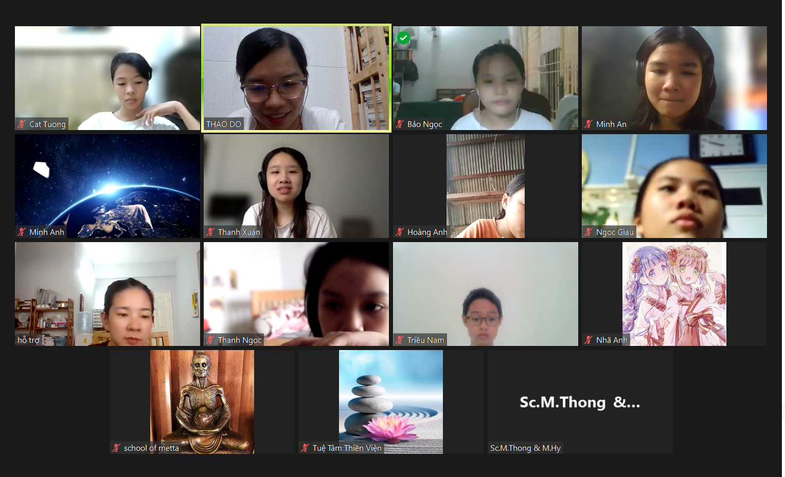
1
2
1
3
1
4
5
7
6
8
10
9

